Slide 1
공개 소프트웨어 프로젝트
Team 10 : Connect 5, 6 AI

Slide 2
Rule-based vs Reinforcement Learning
Build a platform for Programs to Compete with each other
Develop a Reinforcement Learning Based Connect6 Program
Rule-Based Model
Use Open Source SW
Reinforcement Learning Model
Reinforcement Learning Concepts
Zero-based

Slide 3
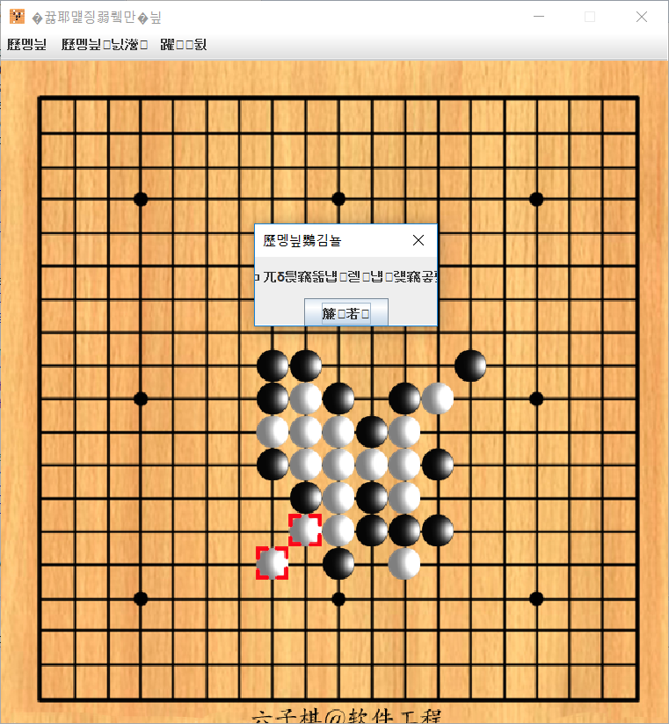
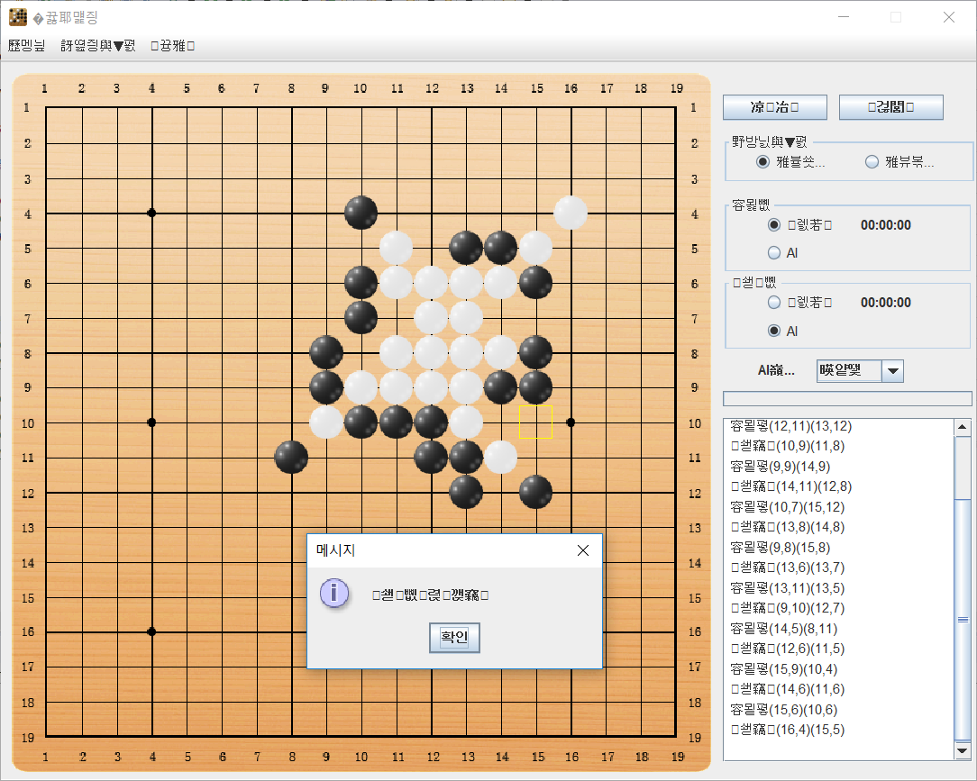
Development Environment
Github repository
Rule-based Models
Connect6-ng-dev
Connect6
Reinforcement Learning
Not been Decided

Slide 4
Project Schedule
주 차 | 6 | 7 | 8 | 9 | 10 | 11 | 12 | 13 | 14 | 15 | 16
 | 10/8~10/14 | 10/15~10/21 | 10/22~10/28 | 10/29~11/04 | 11/05~11/11 | 11/12~11/18 | 11/19~11/25 | 11/26~12/02 | 12/03~12/09 | 12/10~12/16 | 12/17~12/23
오픈소스 조사 & 분석
오목 & 육목 구현
강화학습 적용
테스팅
GUI 구현
조별 시연 발표
프로젝트 마무리 (기말고사)

Slide 5
Thank You for Listening
Team 10 : Connect 5, 6 AI

